Slide 1
Will’s Way to Dashboards and Logging
By William Brown

Slide 2
Introduction
Course Structure
  Six weeks focusing on different areas of programming for FRC
Week 1: Fundamentals of Java and FRC Programming
Week 2: Dashboards and Logging
Week 3: PID Motor Control
Week 4: Swerve Drive
Week 5: Vision and Localization
Week 6: Pathplanner

Slide 3
What is the Dashboard
An window into the mind of the robot
Allows for the live display of values from the robot
Allows users to use fine inputs compared to using just the using joystick inputs
Is extremely helpful for troubleshooting
Uses Network Tables Protocols 4.0

Slide 4
Network Tables
What is NetworkTables 4.0?
A real-time communication system used in FRC
Lets robot code share data with dashboards, coprocessors, and other devices
Built on a fast publish-subscribe (Pub/Sub) architecture
Publisher–Subscriber Model
Publisher: Sends data (robot → dashboard)
Subscriber: Reads data (dashboard → robot or viewer)
Pub/Sub removes the need for manual synchronization and makes data flow efficient

Slide 5
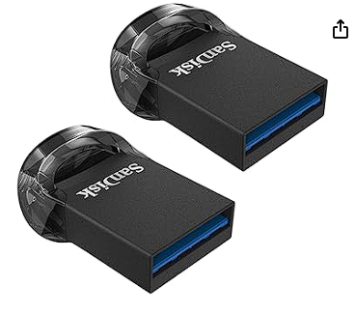
Logging
Why Log Data?
Helps diagnose issues you can’t reproduce
Reveals timing problems, latency, voltage drops
Useful for tuning PID loops, drivetrain behavior, and autos
WPILib DataLogManager
Built-in, automatic logging
Saves logs to a local memory or a USB on the roboRIO
Compatible with AdvantageScope

Slide 6
Logging
Other Logging Resources
CTRE Built In Logging
Built in Logging with Epilogue
AdvantageScope Docs
Videos On Logging and Replay
FRC Data Logging and Visualization
FRC Log Replay and Simulation

Slide 7
Introduction
Course Structure
  Six weeks focusing on different areas of programming for FRC
Week 1: Fundamentals of Java and FRC Programming
Week 2: Dashboards and Logging
Week 3: PID Motor Control
Week 4: Swerve Drive
Week 5: Vision and Localization
Week 6: Pathplanner

